Slide 1
PSEG LONG ISLAND
Ensuring Reliability in the Area: BROOKLYN AVENUE SUBSTATION PROJECT
August 18, 2022

Slide 2
Mission
At PSEG Long Island, our mission is to build an industry leading electric service company that places safety first in all we do, providing our customers across Long Island and the Rockaways with:
Excellent customer service
Best in class electric reliability and storm response
Opportunities for energy efficiency and renewables
Local, caring, and committed employees, dedicated to giving back to their communities

Slide 3
Project Scope – Brooklyn Avenue Substation Project
PSEG Long Island is designing this project to better support the growing power needs in this community.
(Transmission lines carry high voltage power to substations, where the voltage is stepped down to lower levels and sent out into our neighborhoods via distribution circuits.)
The project will construct one new substation and upgrade the transmission and distribution system.
A substation will be built at 48 Brooklyn Avenue, Massapequa, NY, located just north of the LIRR ROW in a Commercial/Industrial area
Replacement and relocation of existing steel transmission poles along the LIRR ROW
Distribution system upgrades throughout the community.
Notes:
Plainview, Ruland Rd, Syosset, and State School

Slide 4
Benefits of a New Substation in Massapequa
PSEG Long Island is responsible for providing reliable electric service for the communities we serve
Recent engineering studies and analysis conducted by PSEG Long Island have concluded that growing energy demands will exceed the capacity of the existing substations and electric circuits in the area. The project will increase reliability and power quality to the area, and will support future load growth
Nearby substations have no land available for expansion and their existing banks and feeders are running out of capacity to support the area during load growth, future load additions, and contingency events

Slide 5
Brooklyn Avenue Substation
A centrally located substation will directly benefit the community by significantly increasing reliability and power quality.
Shorter distribution feeders enhance reliability. Adding centrally-located equipment will reduce the number of customers served by each feeder.
Reduces load and capacity challenges on surrounding substations while providing increased contingency capacity for the entire area
Increased system automation and network monitoring will help restore customers’ electricity more quickly
Increased electric capacity in the area will facilitate routine and necessary system maintenance

Slide 6
Transmission Work
Replacement and relocation of three existing steel transmission poles and associated pole-top equipment and wire, and installation of three new steel transmission poles and wires
The transmission pole replacements will occur along an existing overhead transmission circuit, which is located just north of, and parallel to, the Long Island Rail Road (LIRR) tracks in Massapequa
Pole replacements will occur within this LIRR existing transmission circuit pole alignment
One new transmission pole will be installed within the LIRR pole alignment, and two new transmission poles will be installed within the new Brooklyn Avenue Substation

Slide 7
Transmission Work Cont’d
Description of the transmission facilities to be built:
Three existing steel transmission poles will be replaced with new steel transmission poles that will have a newer type of finish that blends in more naturally with the surrounding environment. These poles are currently approximately 63 to 65 feet in height, and the replacement poles will be approximately 75 feet in height
Of the three new transmission poles that will be installed, two will be approximately 65 feet in height and will be located within the new Brooklyn Avenue Substation, and one will be approximately 75 feet in height and will be installed within the existing transmission circuit pole alignment just north of, and parallel to the Long Island Rail Road (LIRR) tracks in Massapequa. The transmission pole to be installed within the existing transmission circuit pole alignment will have a natina finish, and the transmission poles within the new Brooklyn Avenue Substation will be gray or galvanized steel, to match the color of the surrounding substation equipment
Above ground visual appearance will be more or less similar in visual height as the existing poles

Slide 8
Distribution Work
Five new underground 13kV distribution feeder lines will be installed, exiting the proposed new Brooklyn Avenue Substation and continuing underground along Brooklyn Avenue, Veterans Boulevard, Hicksville Road (Route 107), New York Avenue, Central Avenue, Michigan Avenue and Broadway within Massapequa
Pole work will be completed in areas surrounding the proposed Brooklyn Avenue Substation, including the Village of Massapequa Park and the Hamlets of Massapequa, North Massapequa, Seaford, North Wantagh and Wantagh. This pole work will include the replacement of existing wood utility poles, as well as associated pole-top wire and equipment
Underground cable will also be installed along Jerusalem Avenue and Express Way in Wantagh; Jerusalem Avenue and Hicksville Road (Route 107) in North Massapequa; and Merrick Road, Seaford Avenue and Locust Street in Massapequa

Slide 9
Water Main Relocation
An approximate 140 linear foot section of water main supplying a fire hydrant located within the Town of Oyster Bay-owned property currently bisects the Proposed Substation property. In order to support the construction of the Proposed Substation, this water main will be capped within Brooklyn Avenue, immediately north of the Proposed Substation property.
The fire hydrant will subsequently be supplied by an approximately 200 linear foot section of new water main constructed along Veterans Boulevard, connecting the fire hydrant to an existing water main located near the intersection of Veterans Boulevard and Hicksville Road (Route 107).
After the new service is installed, the section of water main currently bisecting the Proposed Substation property will be removed.

Slide 10
Project Timeline
September 2022 - Civil work to begin
November 2022 - Electrical work to begin
June 2023 - Energize New Substation

Slide 11
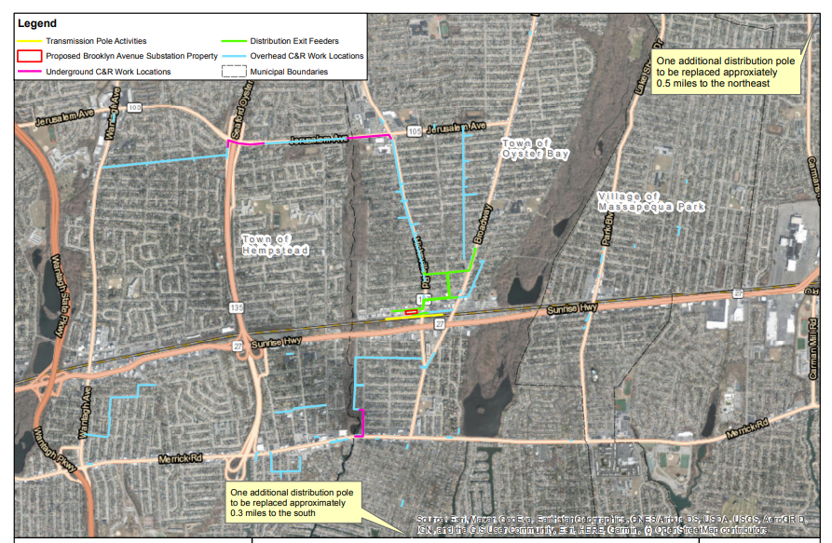
Transmission & Distribution Map and Route

Slide 12
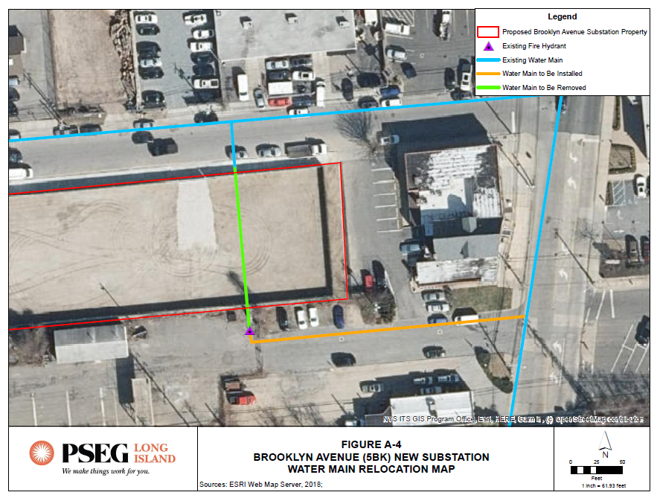
Water Main Relocation Map

Slide 13
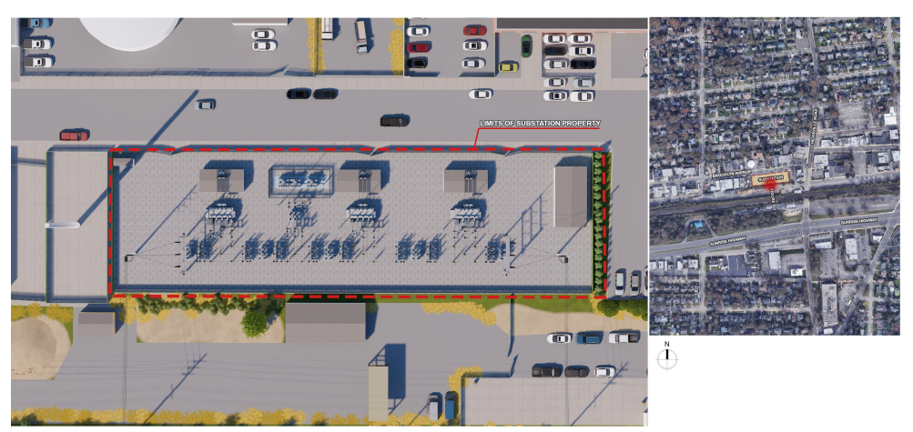
Brooklyn Avenue Substation Rendering

Slide 14
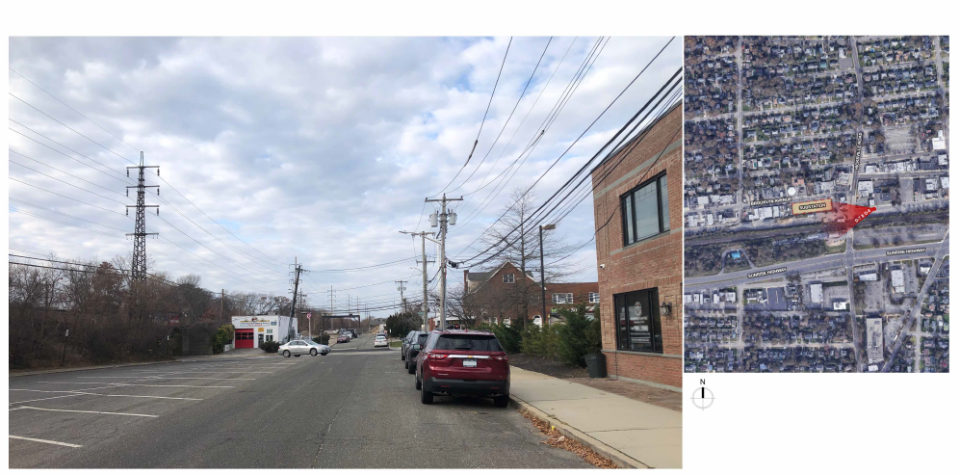
Brooklyn Avenue Substation Photo Simulations - Existing

Slide 15
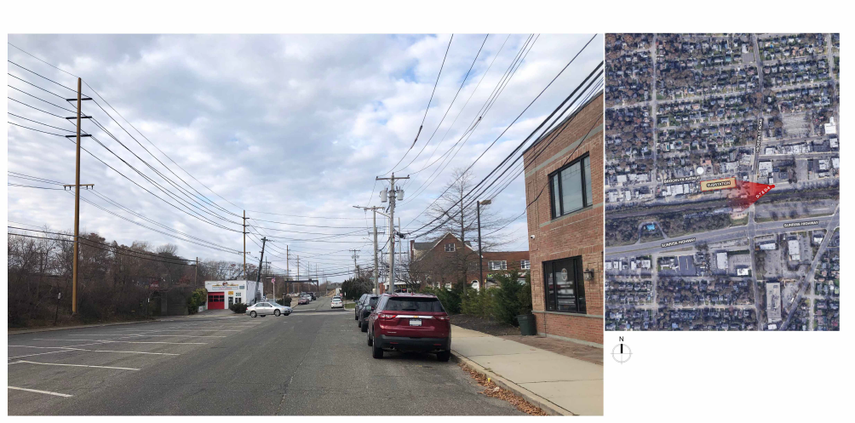
Brooklyn Avenue Substation Photo Simulations - Proposed

Slide 16
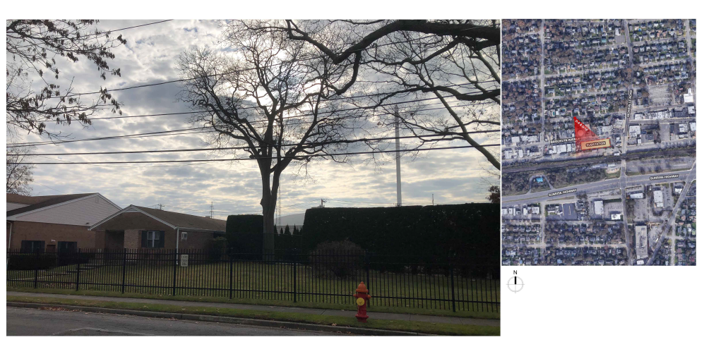
Brooklyn Avenue Substation Photo Simulations - Existing

Slide 17
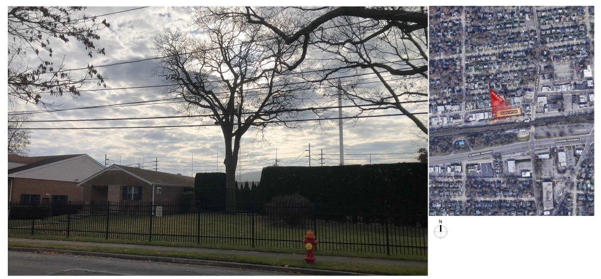
Brooklyn Avenue Substation Photo Simulations - Proposed

Slide 18
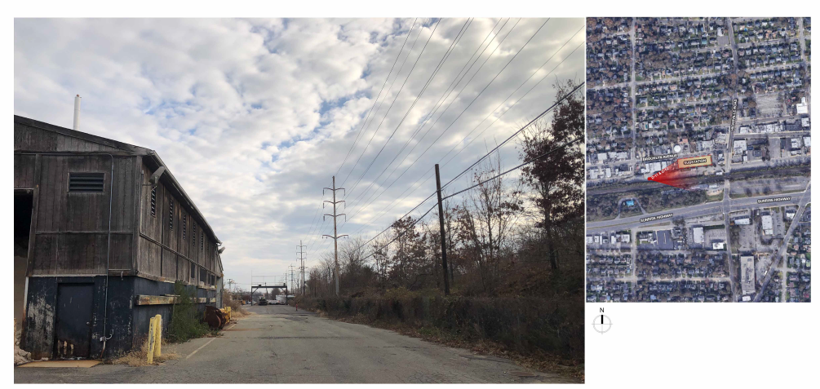
Brooklyn Avenue Substation Photo Simulations - Existing

Slide 19
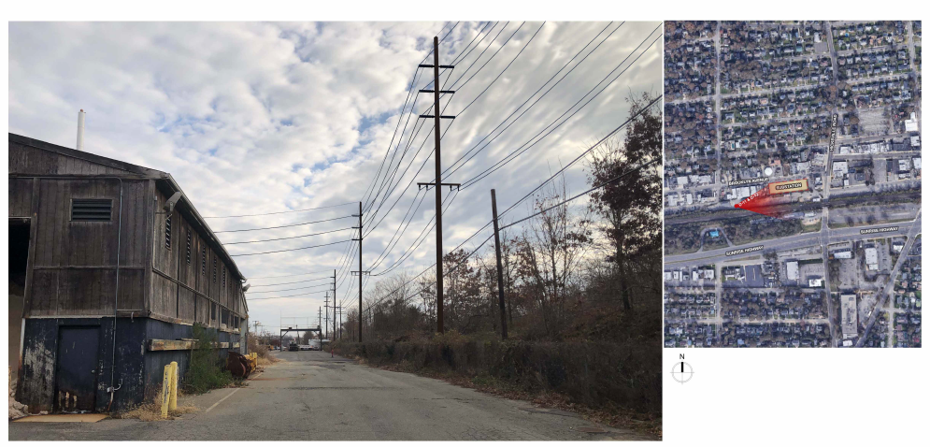
Brooklyn Avenue Substation Photo Simulations - Proposed

Slide 20
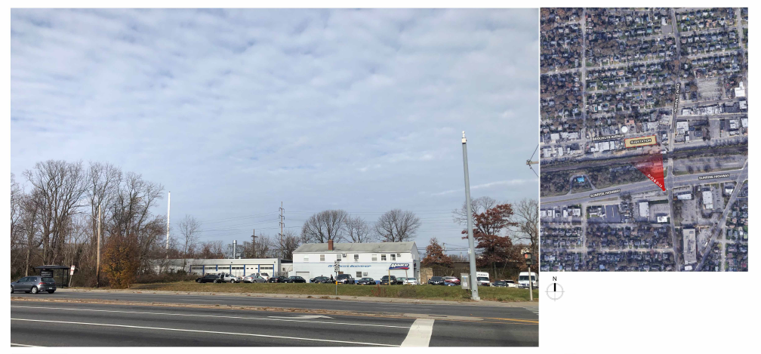
Brooklyn Avenue Substation Photo Simulations - Existing

Slide 21
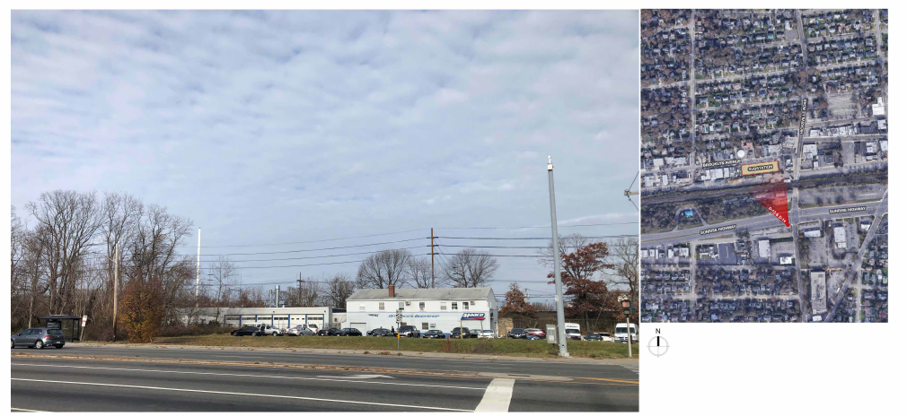
Brooklyn Avenue Substation Photo Simulations - Proposed

Slide 22
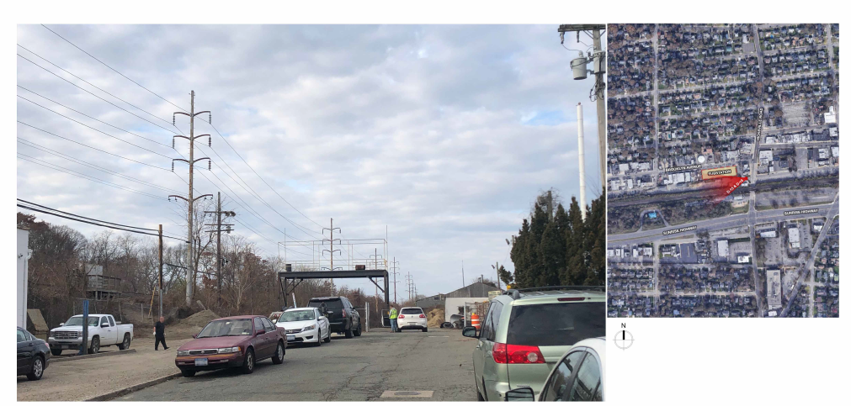
Brooklyn Avenue Substation Photo Simulations - Existing

Slide 23
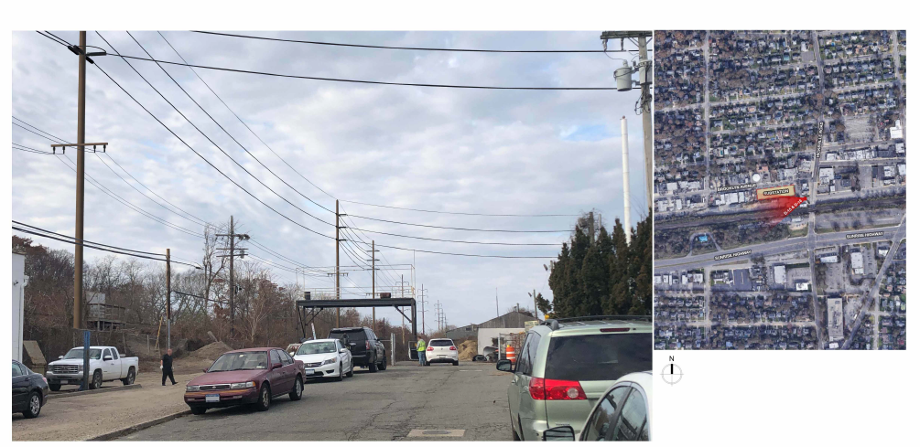
Brooklyn Avenue Substation Photo Simulations - Proposed

Slide 24
Safety & Construction
PSEG Long Island continues to operate, providing safe and reliable electricity to more than its 1.1 million customers. PSEG Long Island, like many companies, has implemented robust business continuity plans and emergency procedures during the COVID-19 outbreak
Contractors performing work for this project have provided PSEG Long Island with their safety plans, which meet current regulatory requirements with respect to COVID-19, including physical distancing measures
PSEG Long Island will provide cones, flaggers and signage at the work sites
For more information on our response to the pandemic, please visit www.psegliny.com/covid19

Slide 25
Community Outreach
Customer notification to those within the vicinity of project:
Letters
Robo calls - for planned outages
Email and text messages – as needed
Dedicated webpage providing project details

Slide 26
How to get in touch
Our website: https://www.psegliny.com/reliability/BrooklynAveSubProject
Our Survey: https://www.psegliny.com/inthecommunity/currentinitiatives/reliabilityprojects
Email: ExternalAffairsLI@pseg.com
Contact us at: 1-800-490-0025

